Slide 1
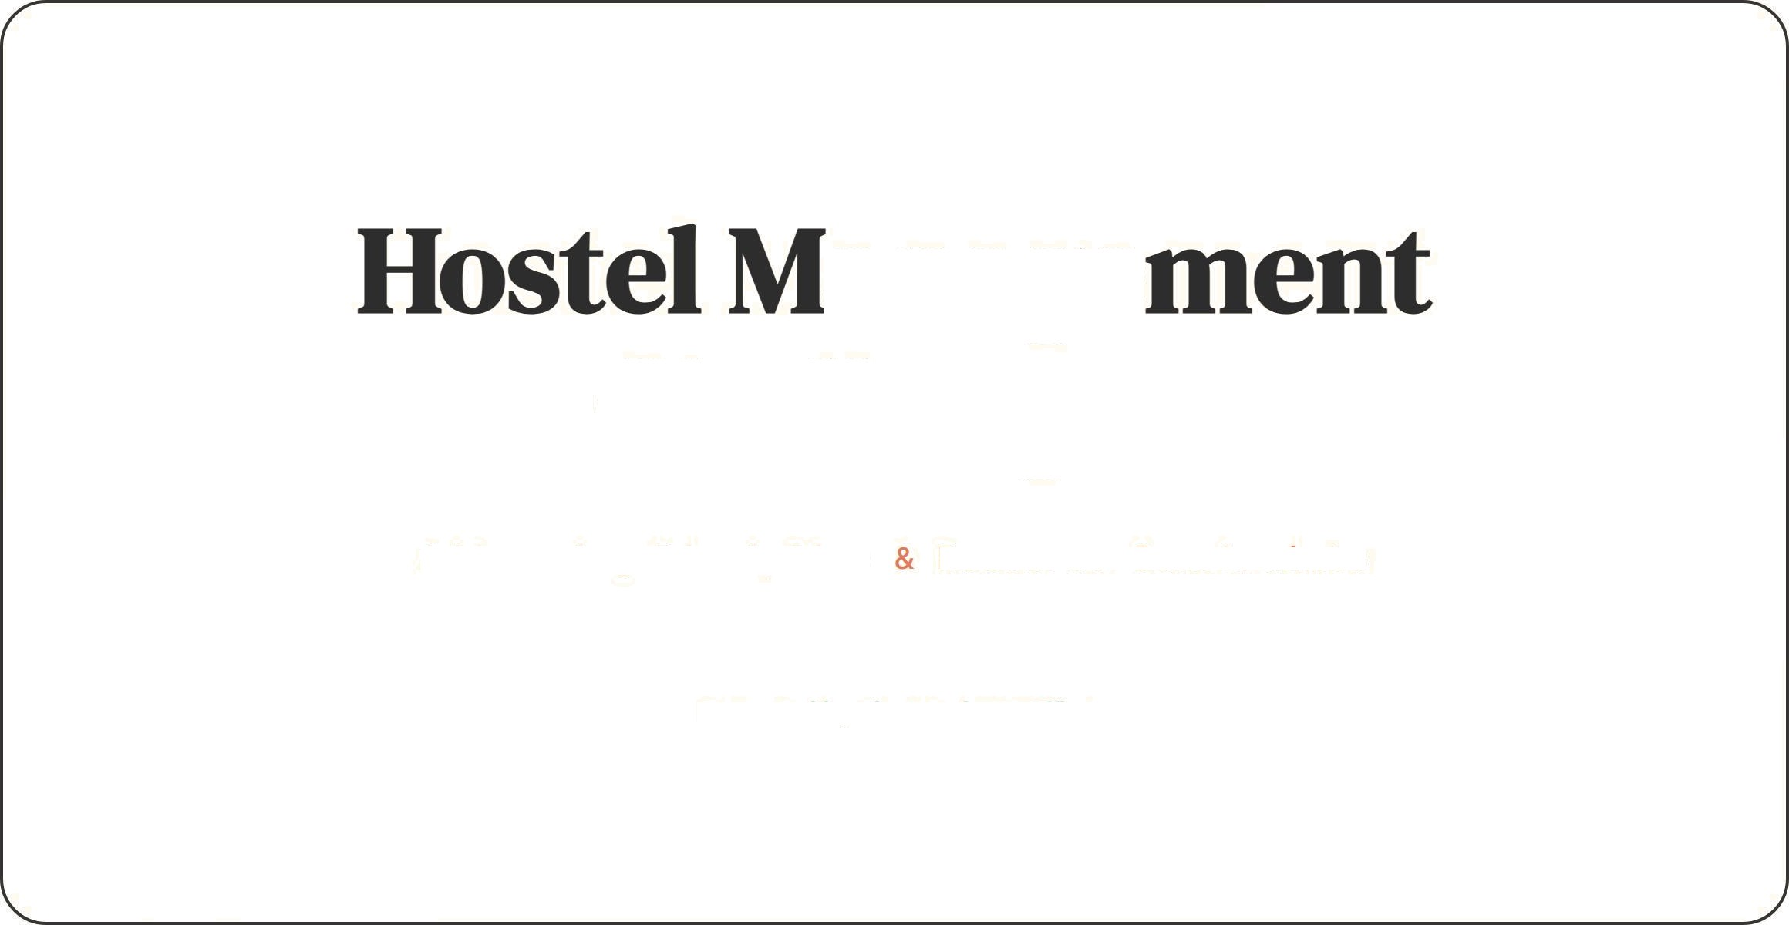
anage ChAlenges
Addressing Discipline Resource Constraints
Presented by The Warden's Office

Slide 2
The Current Landscape
Ie
D%iplinary Issues
e° Resowce Shortage
We are operating under a constrained budget that has not kept pace with inflation or wear-and-tear.
Essential repairs are being delayed, leading to deteriorating infrastructure, plumbing failures, and a lack of basic amenities.
Student non-compliance has risen significantly. The primary concerns are late entries beyond curfew and a general disregard for hostel timings.
This behavior compromises the security of the premises and disrupts the study environment for other residents.

Slide 3
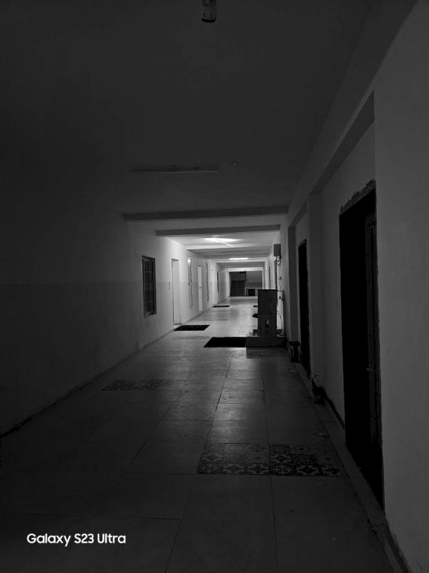
Problem Area: Non-Compliance
Late Entry Risks: Students returning after gates close create security vulnerabilities and require extra staff monitoring.
a Ignoring Timings: Disregard for quiet hours and mess timings disturbs the community order.
A Rule Enforcement Gap: Current manual monitoring
is ineffective against persistent violators.
@ Impact: A chaotic environment that affects academic performance and safety.

Slide 4
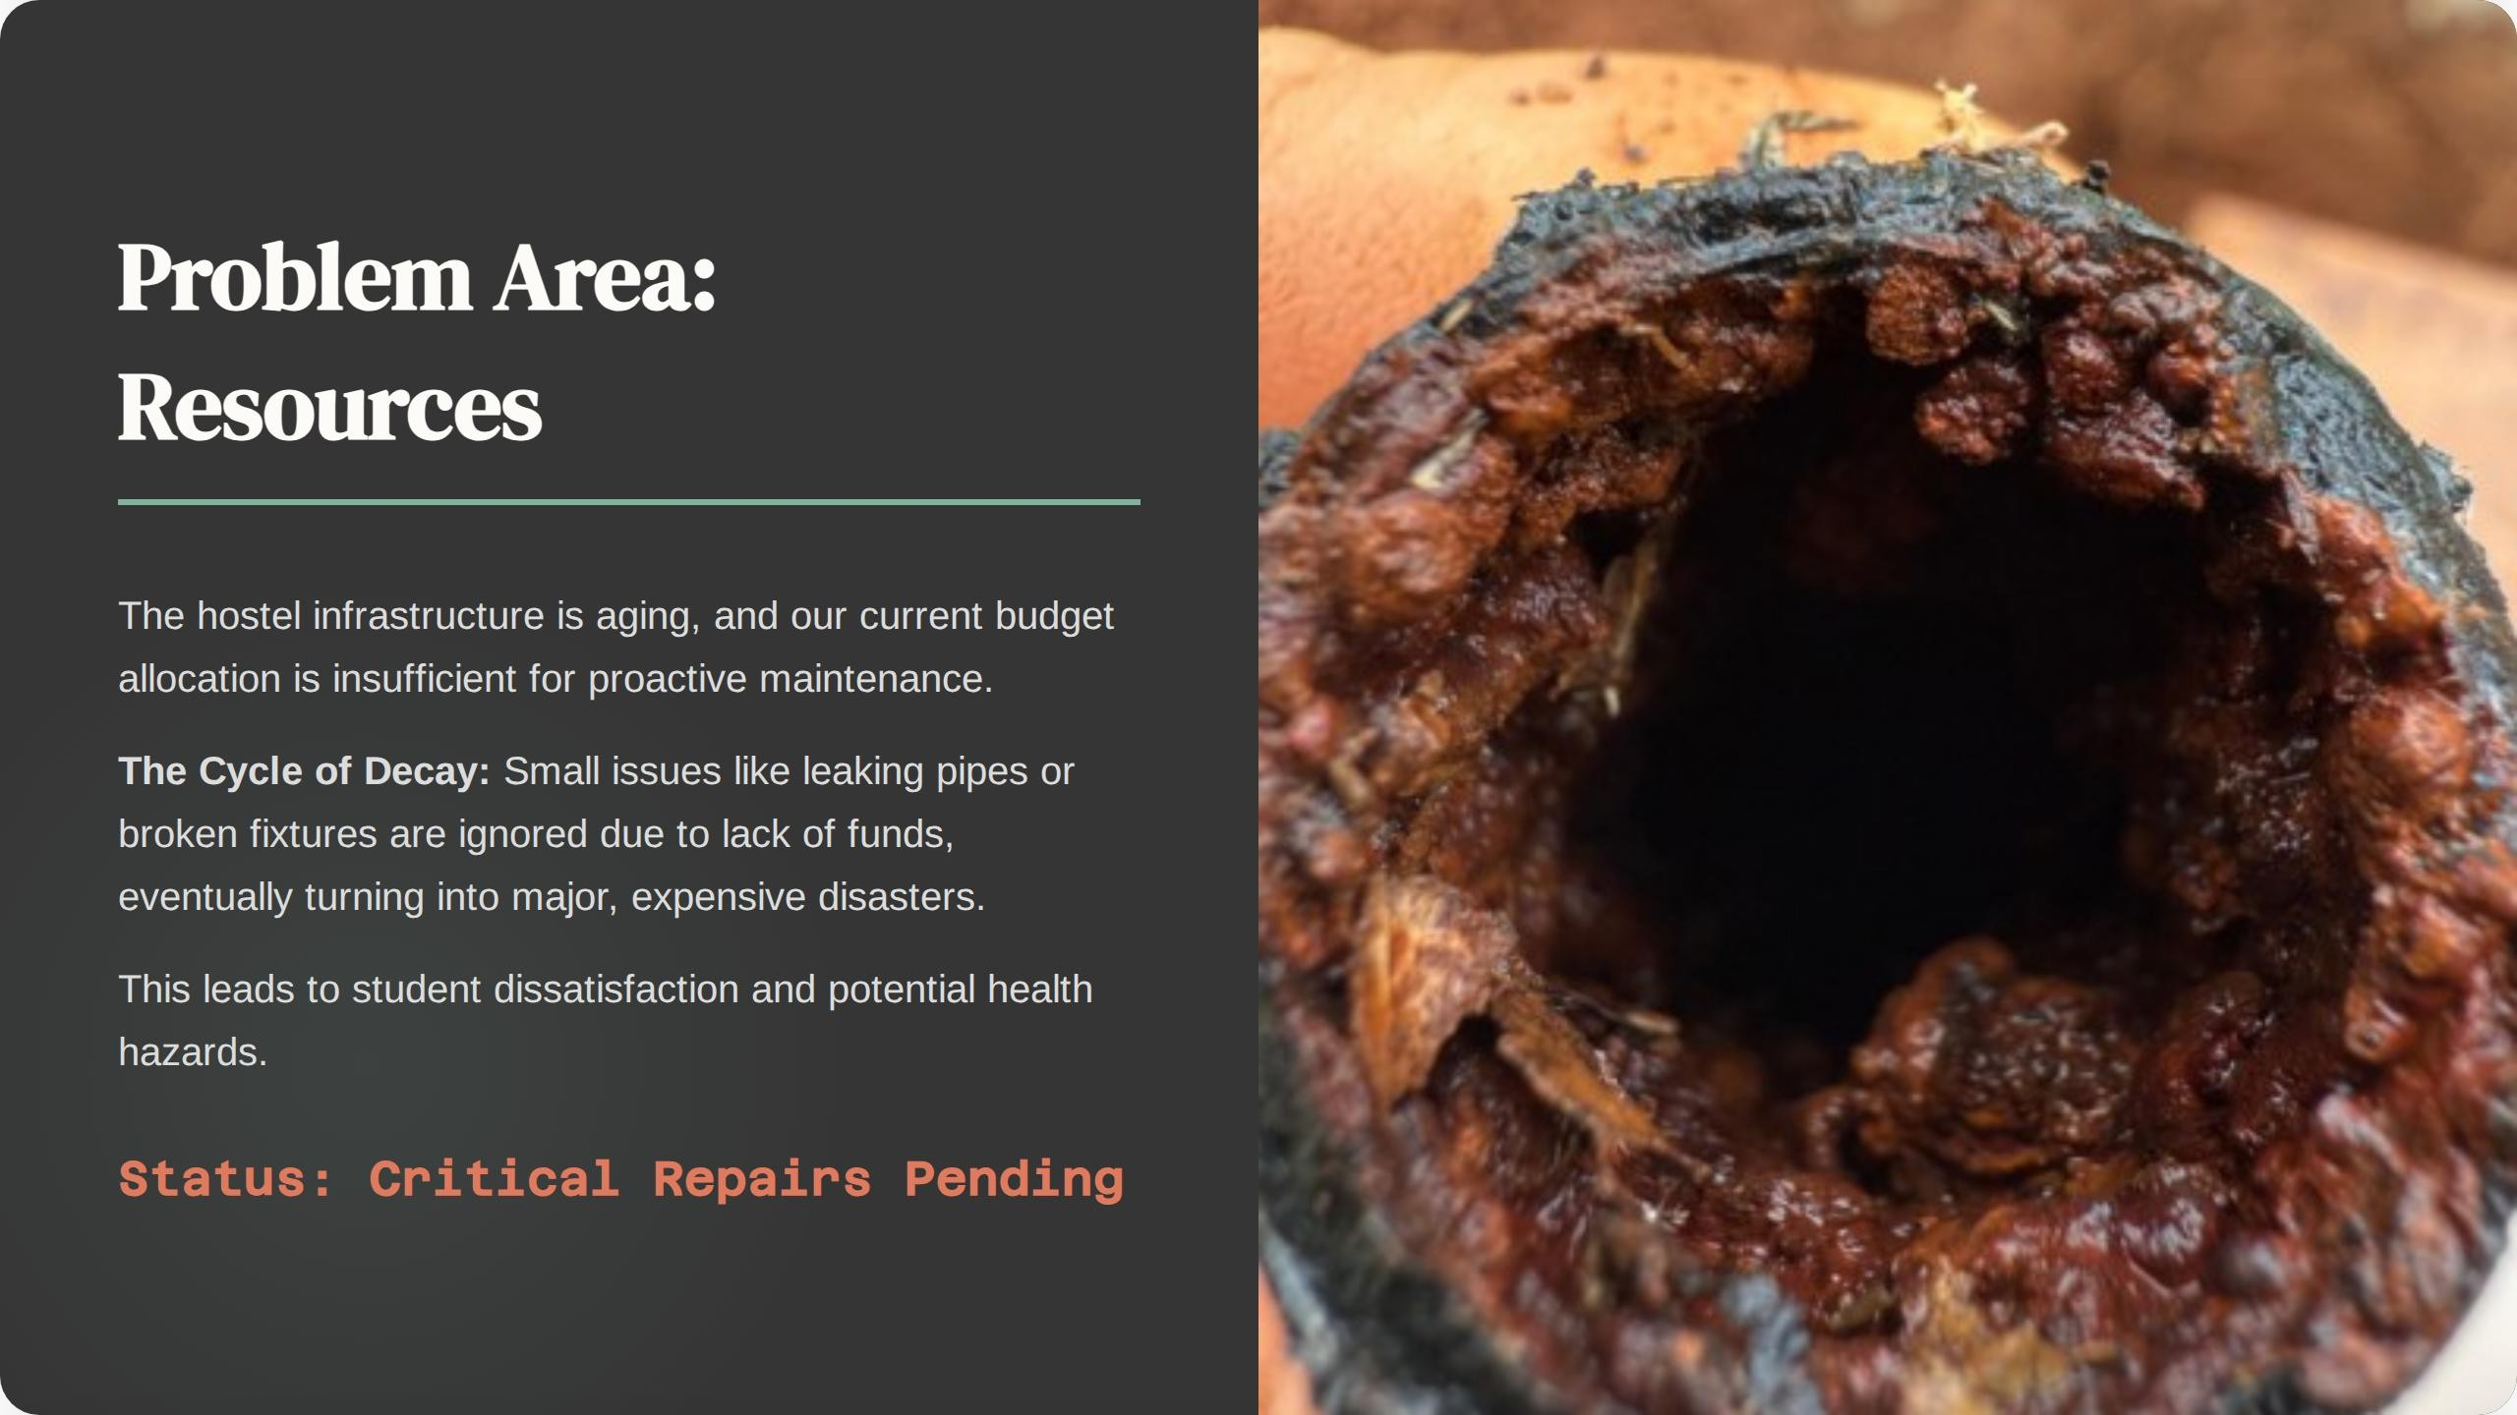

Slide 5

Stmtegic Solutions
Tiered Penalties
Introduce a transparent system of escalating fines for repeat offenders to deter rule-breaking effectively.
Maintenance Ftind
Request a specific "Emergency Repair Grant" from the administration and initiate a preventive maintenance schedule.
Implement biometric access control to automate attendance and strictly enforce curfew timings without bias.

